Slide 1
Optimising Easter
with David Smith & Google OR-Tools

Slide 2

Meet the
Easter Bunny!
He must plan the perfect easter egg hunt each year.

Slide 3

But this is getting increasingly challenging.

Slide 4

With the endless:
Dietary requirements
Child preferences
Supply chain issues

Slide 5

With the endless:
Dietary requirements
Child preferences
Supply chain issues
Trump’s tariffs
GDPR requirements
& the cost of living…

Slide 6

His old pen & paper
process is no longer cutting it…

Slide 7
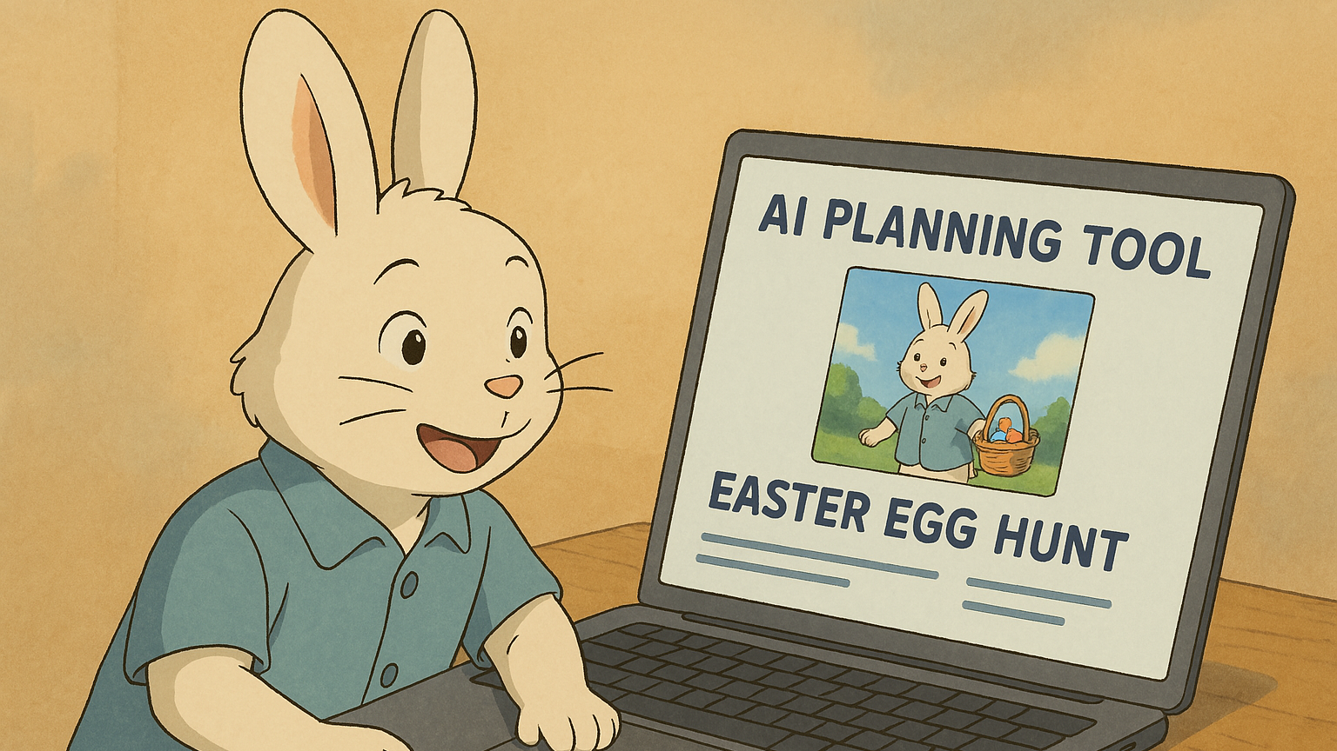

Slide 8

The easter bunny has hired us, tired consultants,
to help him build a tool to optimise his egg hunt.

Slide 9
So lets get to it!

Slide 10
How do we solve an optimisation problem?
Linear Programming is a good place to start.
Simplicity: LP models are straightforward to formulate and understand.
Efficiency: LP problems can be solved efficiently using well-established algorithms.
Global Optimum: LP problems are convex, meaning they have a single global optimum.
Wide Applicability: LP can be applied to a variety of real-world problems - resource allocation, transportation, and production planning

Slide 11

Designing the Solution
Understand processes & problems.
Model processes and calculations.
Design and model constraints.
Iteratively add complexity as required.
Validate with the client.
Think about user experience.

Slide 12

Let’s work with the client to understand the logic and model the problem.

Slide 13
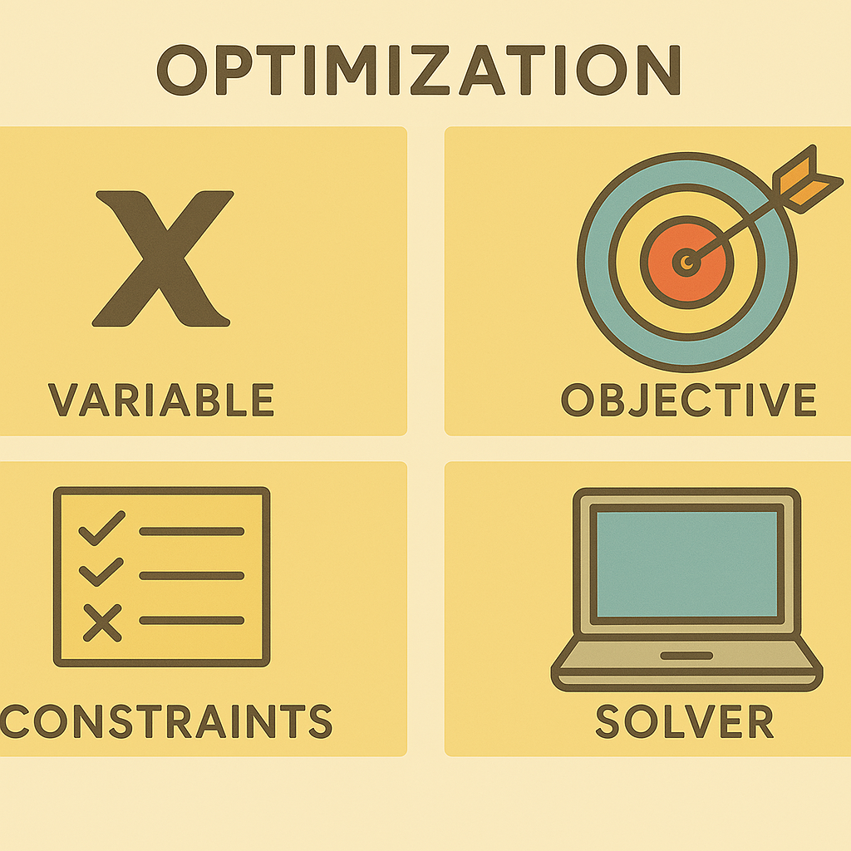
Components of Optimisation Problems

Slide 14

Understand the System
How is the bunny solving this problem?
What involved & how do they interact?
Houses
Children
Eggs
What parameters need to be controlled or are required?

Slide 15

Define the Variables
What are decision variables?

Slide 16
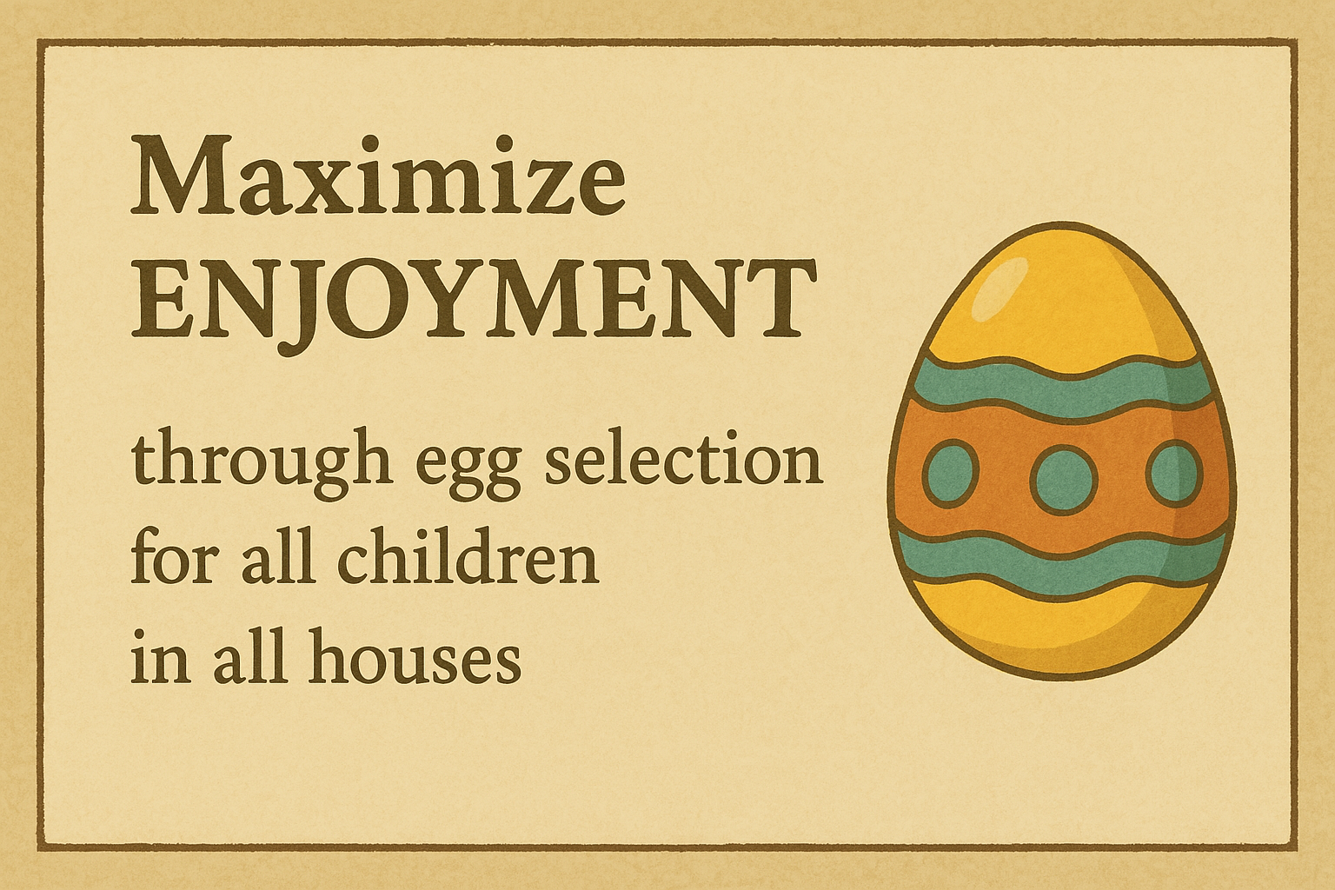
Define the Objective

Slide 17
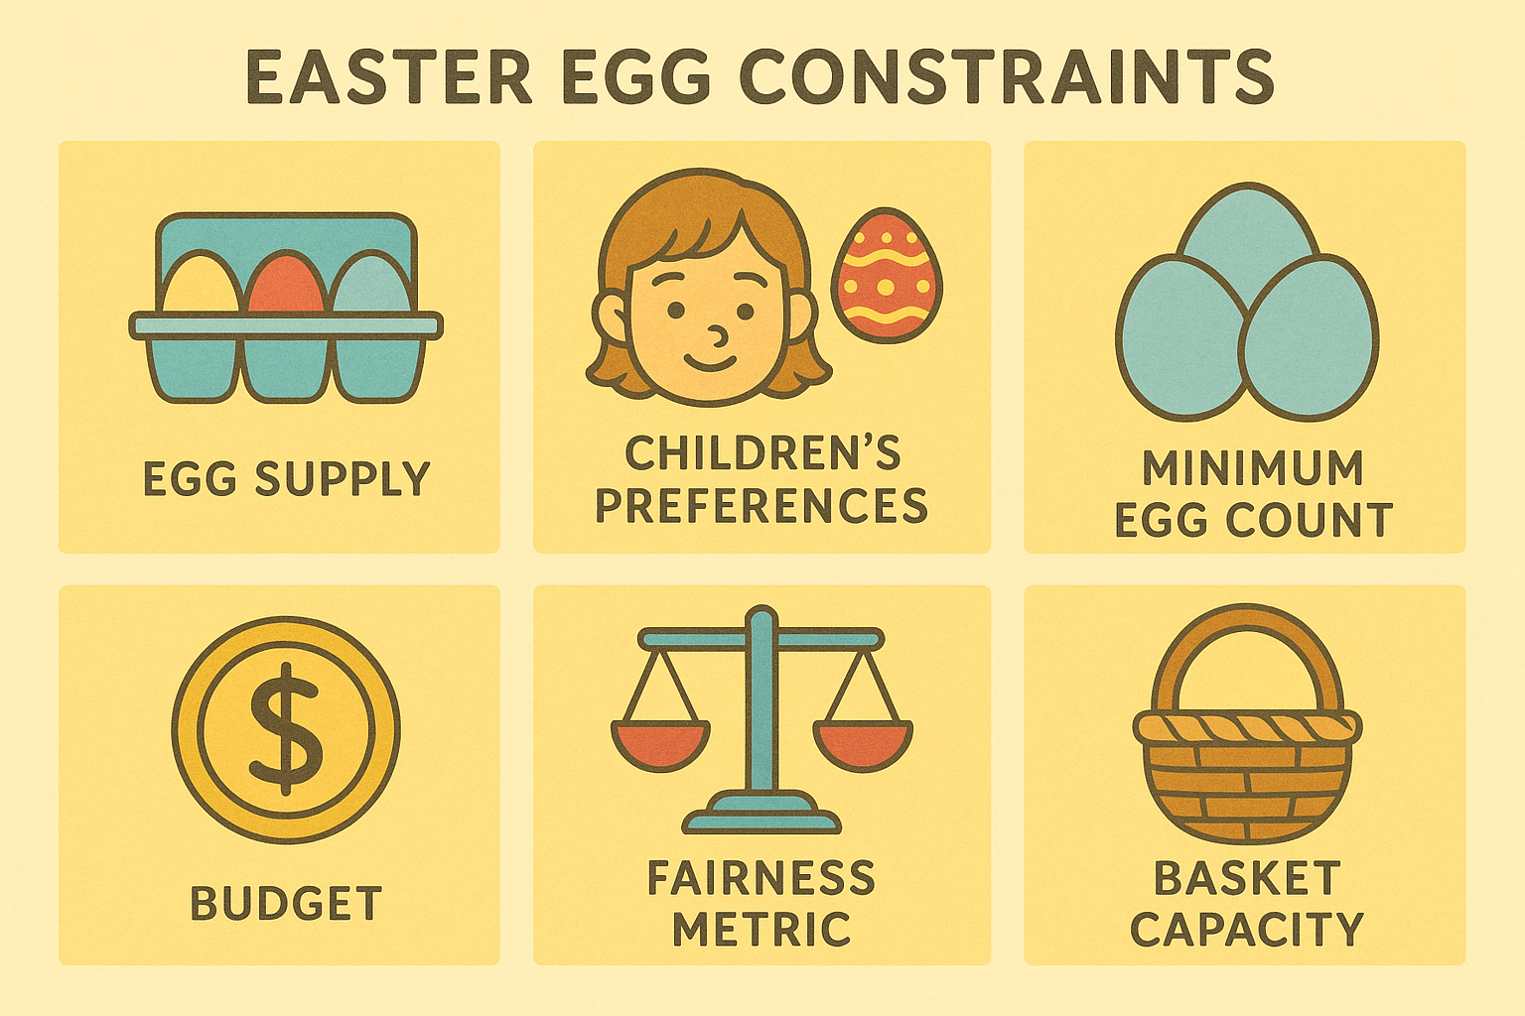
Model The Constraints

Slide 18
Multi-purposed SciPy,
Beginner-friendly PuLP,
Exhaustive Pyomo
Many others…
Google OR-Tools,
Quite user-friendly
Several prepackaged solvers
Nice syntax
Select Your Solver Library

Slide 19
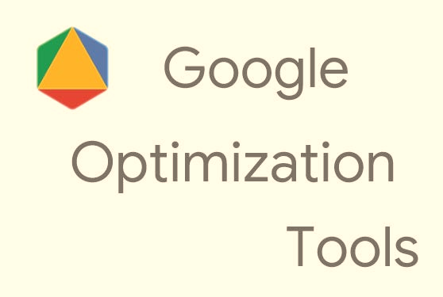
Interface to different solvers
Abstract model logic
Nice syntax and developer experience
Models
GLOP (Google Linear Optimization Package)
SCIP
Gurobi (requires license)
Cplex (requires license)

Slide 20
Linear
Objective function and constraints are linear.
Always convex, leading to a single global optimum.
Simplicity and efficiency in solving large-scale problems.
Guaranteed global optimum if feasible.
Non-linear
Objective function or constraints are nonlinear.
May be non-convex, leading to multiple local optima.
Flexibility in modelling a wide range of practical scenarios.
Handles complex, real-world problems with nonlinear relationships.
Select Your Solver Model

Slide 21
OR Tools Model Structure
Import solver
Declare variables
Define objective
Define constraints
Solve

Slide 22

Let's look at some code.

Slide 23

UI & Documentation
Convert markdown documentation to word using Pandoc
Hook up a Streamlit solution for fast prototyping
Then, of course… PowerPoint.

Slide 24

The Easter Bunny is happy with his solution!

Slide 25
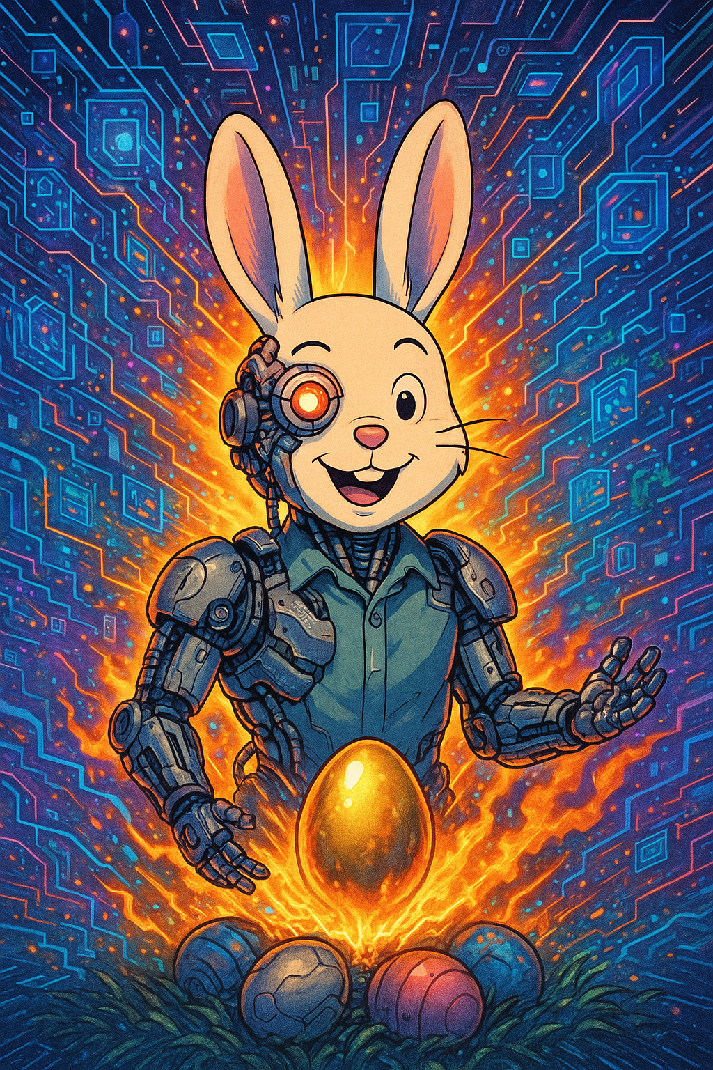
Reborn.
Powerful.
One with Tech.
But…

Slide 26

Poor…
He spent all his money
on consulting fees.

Slide 27

So now, he plans his next budget conscious egg hunt.
Home-brand, black and gold eggs for all!

Slide 28
You should know where to start when
solving optimisation problems for clients like the Easter Bunny.

Slide 29


If you would like the slides & code, connect with me below!

